Slide 1
BiteBuddy: Business Relationship Map
Advertising Management Group
SUPPLIERS
ORGANIZATIONS SELECTED PARTS
(INTERNAL STAKEHOLDERS)
CUSTOMERS
Platform Administrator (BiteBuddy)
Payment Gateway Providers
Diners
(Food Enthusiasts / Busy Professionals)
(BiteBuddy)
Restaurant Partners
Customer Support Team
(BiteBuddy)
Cloud Service Providers
Advertising Management Group
(BiteBuddy)
Restaurant Owners (Vendors)
(BiteBuddy)
Marketing & Advertising Agencies
Finance & Operations Team
(BiteBuddy)

Slide 2
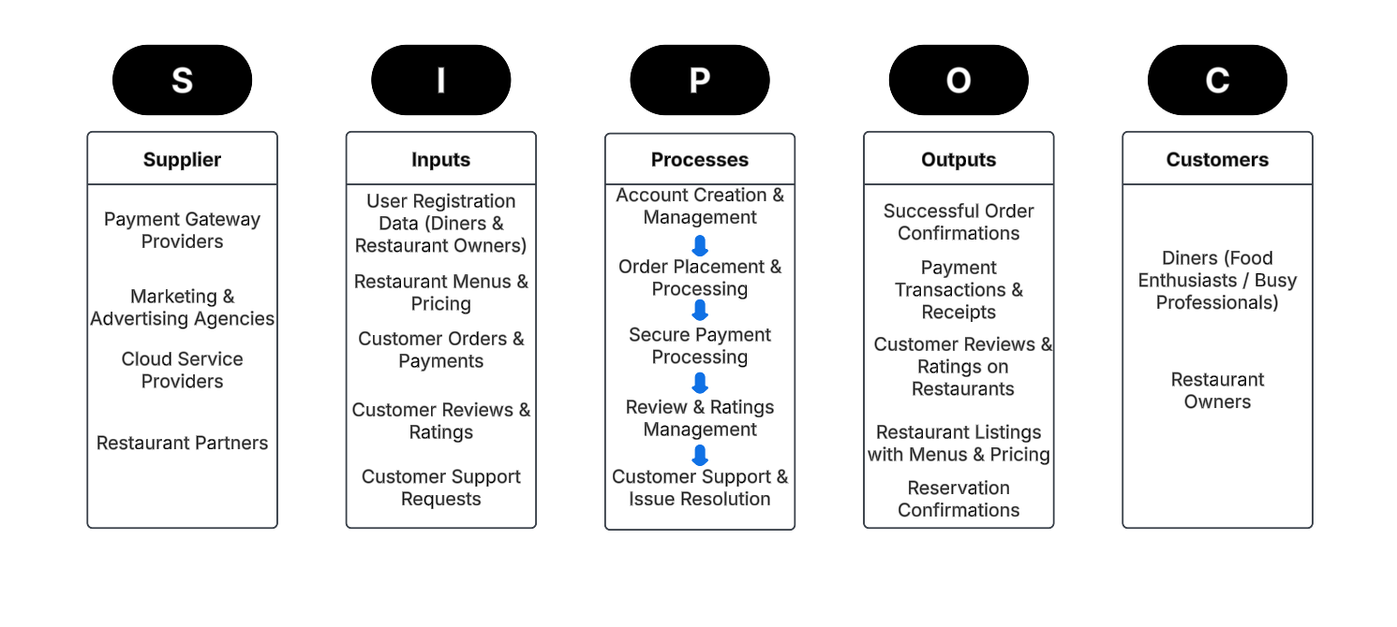
BiteBuddy: Business Relationship Map

Slide 3
BiteBuddy: User Roles by Business Group
External Users (Customers)
Restaurant Partners (Kuldeep Saindane)
Diners (Fouzan Ahmed Mir)
Internal Users
Business Group | User Roles | Team Member Name
Platform Administrator | System Administrator, Platform Manager | Saily Sambhaji Jadhav Hani Thummar
Finance & Operations Team | Accountant, Operations Manager | Tarun Chegu Tejashwini Devikoppa Suresh
Advertising Management Group | Marketing Manager, Data Analyst | Vishnuvardhan Chintamreddy Dezil Vinodkumar Modi
Customer Support Team | Technical Support Specialist, Call Center Support | Sai Krishna Rao Pippera Vineeth Sai Movva

